Slide 1
IP Fragmentations
An IPv4 packet has arrived with the first 8 bits as shown:
01000010
The receiver discards the packet. Why?
Solution
There is an error in this packet. The 4 leftmost bits (0100) show the version, which is correct. The next 4 bits (0010) show an invalid header length (2 × 4 = 8)
The minimum number of bytes in the header must be 20. The packet has been
corrupted in transmission

Slide 2
2. In an IPv4 packet, the value of HLEN is 1000 in binary. How many bytes of options are being carried by this packet?
Solution
The HLEN value is 8, which means the total number of bytes in the header is 8× 4, or 32 bytes
The first 20 bytes are the base header, the next 12 bytes are the options.
3. In an IPv4 packet, the value of HLEN is 5, and the value of the total length field is 0x0028. How many bytes of data are being carried by this packet?
Solution
The HLEN value is 5, which means the total number of bytes in the header is 5
× 4, or 20 bytes (no options)
The total length is 40 bytes, which means the packet is carrying 20 bytes of data
(40 − 20)

Slide 3
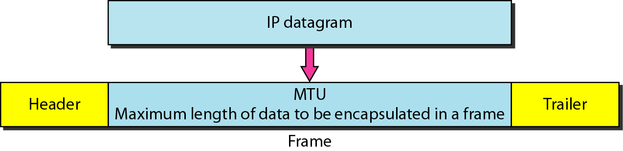
Maximum transfer unit (MTU)

Slide 4

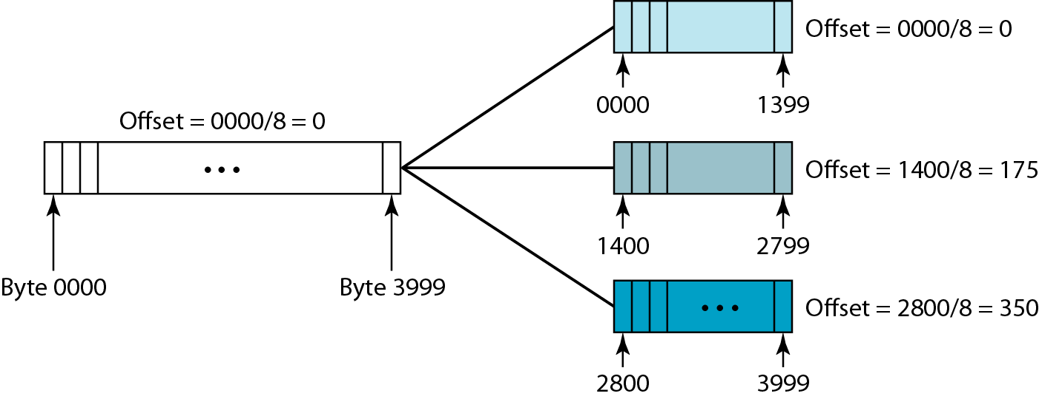
Fragmentation example
Flags used in fragmentation

Slide 5
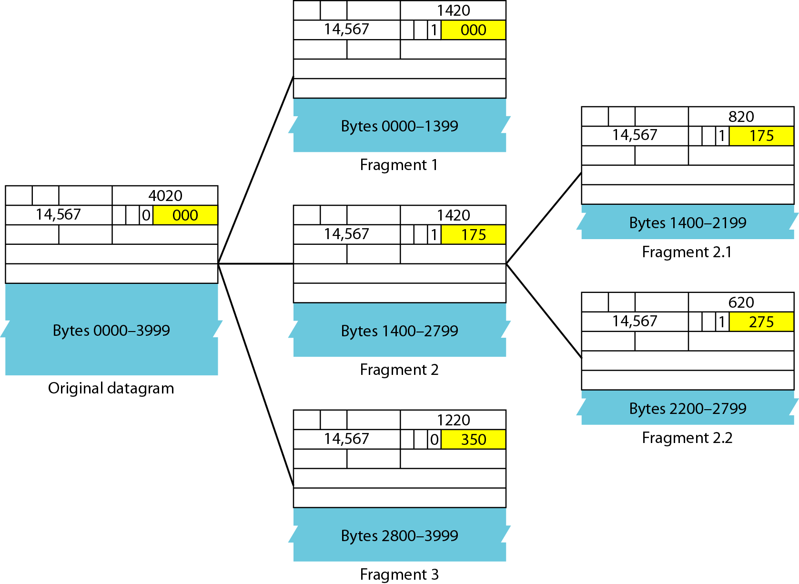
Detailed fragmentation example

Slide 6
A packet has arrived with an M bit value of 0. Is this the first fragment, the last fragment, or a middle fragment? Do we know if the packet was fragmented?
Solution
If the M bit is 0, it means that there are no more fragments; the fragment is the last one
However, we cannot say if the original packet was fragmented or not. A non-
fragmented packet is considered the last fragment

Slide 7
A packet has arrived with an M bit value of 1. Is this the first fragment, the last fragment, or a middle fragment? Do we know if the packet was fragmented?
Solution
If the M bit is 1, it means that there is at least one more fragment. This fragment can be the first one or a middle one, but not the last one
We don‟t know if it is the first one or a middle one; we need more information
(the value of the fragmentation offset)

Slide 8
A packet has arrived in which the offset value is 100, the value of HLEN is 5, and the value of the total length field is 100. What are the numbers of the first byte and the last byte?
Solution
The first byte number is 100 × 8 = 800
The total length is 100 bytes, and the header length is 20 bytes (5 × 4), which means that there are 80 bytes in this datagram. If the first byte number is 800, the last byte number must be 879

